Slide 1
QoS--2
王川耘

Slide 2
Network layer solutions
Trigger-Based Distributed QoS Routing protocol (1)
TDR
  Utilizes GPS
  Each node maintains the local neighborhood information and active routes only
  INIR (Intermediate Node Initiated Rerouting)
    Rerouting is attempted from the location of an imminent link failure
  SIRR (Source Initiated ReRouting)
    Rerouting is attempted from the source
Database management
  For each neighbor, each node maintains received power level, current geographic coordinates, velocity, and direction of motion

Slide 3
Network layer solutions
Trigger-Based Distributed QoS Routing protocol (2)
Activity-based database
  The node maintains a source table (STn), a destination table (DTn), or an intermediate table (ITn)
    Depending on the role of the node in current session
    A flag indicating the node’s activity – NodActv
      NodActv = 0, means idle
  Also maintains an updated residual bandwidth (ResiBWn)
  Databases are refreshed when packets belonging to the on-going sessions are received

Slide 4
Network layer solutions
Trigger-Based Distributed QoS Routing protocol (3)
Initial route discovery
    The entry in source table is made, and NodActv sets to 0 (idle)
    Selects the neighbors
    1) lying closely toward the destination
    2) with power level more than a threshold (Pth1)
    and forward them a route discovery packet
    The intermediate node checks if such packet was received
      Yes → discard
      NO → checks the ResiBW to meet the requirements
      YES → an entry in IT is made, and NodActv sets to 0 (idle)
      forwards the packets with hop count +1
    4. Upon receiving the first packet, if destination is able to satisfy the ResiBW and MaxBW, the route is made, and the ACK is sent back to source along the route
Route/ Reroute acknowledgement
  All the nodes along the route set the NodActv to 1 (active) and refesh their ResiBW status

Slide 5
Network layer solutions
Trigger-Based Distributed QoS Routing protocol (4)
Alternate Route Discovery
  In SIRR
      When the received power level at an intermediate node falls below a threshold Pth2, the intermediate node sends a rerouting indication to source
  In INIR
      When the power level falls below the threshold Pth1 (Pth1 > Pth2), a status query packet is sent toward the source with a flag route repair status (RR_stat) set to 0
      If the upstream nodes are in rerouting process
        The RR_stat is set to 1, and reply back to the querying node
      If the query packet reaches source, the packet is discarded
    If the querying node receives no reply
      The SIRR could be triggered ( power level falls below Pth2)
      Or simply give up the control of rerouting
Route Deactivation
  The source sends a route deactivation packet toward the destination
  The nodes received the packet update their ResiBW, and IT

Slide 6
Network layer solutions
Trigger-Based Distributed QoS Routing protocol (5)
Advantages
  Reduced control overhead
  Reduced packet loss during path breaks
Disadvantages
  Threshold value?
    Fading / multi-path propagation/ velocity …etc

Slide 7
Network layer solutions
QoS AODV (1)
QoS Extensions to AODV protocol
  Modifications are made in routing table, RouteRequest and RouteReply packet
  The following fields are appended to routing table entry
    Max delay
    Min available bandwidth
    List of sources requesting delay guarantees
    List of sources requesting bandwidth guarantees

Slide 8
Network layer solutions
QoS AODV (2)
Max delay extension field
  In a RouteRequest msg.
    Indicates the max time (sec) allowed for a transmission for the current node to the destination
    The node compares its node traversal time (the time processing a packet) to the delay field in RouteRequest msg.
      If delay field is bigger, the msg. is discarded
      Otherwise, delay field = delay field – node traversal time
  In a RouteReply msg.
    Indicates the current estimation of cumulative delay for the current intermediate node to the destination
    The destination node reply a RouteReply msg. to the source with the max delay field set to 0
      Each node forwarding the RouteReply add its own node travaersal time, and update the field
  The routing table in the node is also updated

Slide 9
Network layer solutions
QoS AODV (3)
Min bandwidth extension field
  In a RouteRequest msg.
    Indicates the min bandwidth (Kbps) that must be available along the path
    The node compares its available bandwidth to the min bandwidth field in RouteRequest msg.
      If the field is smaller, the msg. is discarded
      Otherwise, processes the msg. like usual AODV
  In a RouteReply msg.
    Indicates the min bandwidth available on the route between the source and destination
    The destination node reply a RouteReply msg. to the source with the min bandwidth field set to infinity
      Each node forwarding the RouteReply compares its own link capacity to the BW field, and update the field
  The routing table in the node is also updated

Slide 10
Network layer solutions
QoS AODV (4)
List of sources requesting QoS guarantees
  A QoSLost msg. is generated when
    An intermediate node’s traversal time increases, or
    A link capacity decreases
  The QoSLost msg. is forwarded to all sources that could be affected by the change (RouteReply msg. has been forwarded to)
Advantages
  Simplicity in provisioning QoS of extensions in AODV
Disadvantages
  Difficult to provide hard QoS
    No resources are reserved along the path
  Major part of delay is packet queuing delay, and contention at the MAC layer, not the packet processing time

Slide 11
Network layer solutions
Bandwidth Routing Protocol(1)
The BR protocol consists of 3 algorithms
  An end-to-end path bandwidth calcucation algorithm
  A bandwidth reservation algorithm
  A standby routing algorithm
The goal of this protocol is to find a shortest path satisfying the bandwidth requirement
Only bandwidth is considered to be QoS parameter
  In TDMA, bandwidth is measured in terms of the number of free slots available at a node
  Each frame is divided into 2 phases: control phase and data phase
  Bandwidth :
  the set of common free slots between 2 adjacent nodes
The BR protocol assumes a half-duplex CDMA-over-TDMA system in which 1 packet can be transmitted in 1 slot

Slide 12
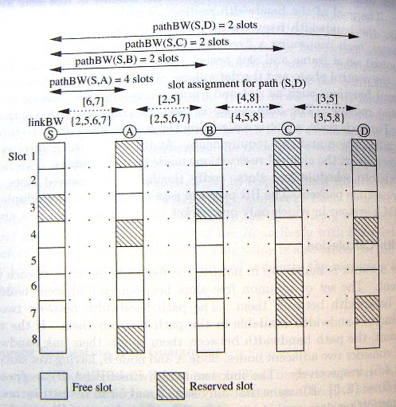
Network layer solutions
Bandwidth Routing Protocol(2)
Bandwidth calculation
1. pathBW(S,A)
= linkBW(A,S) = {2,5,6,7}
2. pathBW(S,B)
since linkBW(A,B) = {2,3,6,7},
we assign slots [6,7] on link(S,A), and [2,5] on link(A,B)
3. pathBW(S,C)
since linkBW(B,C) = {4,5,8},
we assign slot[4,8] on link(B,C)
4. pathBW(C,D)
since linkBW(C,D) = {3,5,8}
we assign slot[3,5] on link(C,D)

Slide 13
Network layer solutions
Bandwidth Routing Protocol(3)
Slot assignment
  Requires periodic exchange of bandwidth information
  Assigns free slots during the call setup
    When a node receives a call setup packet,
    it checks if the slot that sender will use is free or not, it also checks if there is free slots for forwarding the incoming packets
    Yes →
    reserves the slot, updates the routing table, forwards the call setup packet
    No →
    sends a Reset packet back to sender along the path to release the slots assigned for this connection along the path
    If the connection has been set up, the destination sends a reply packet back to the source
  The reservations are soft state to avoid resources lock-up due to the path breaks

Slide 14
Network layer solutions
Bandwidth Routing Protocol(4)
Standby routing mechanism
  To re-establish a broken connection, using DSDV (Destination-Sequenced Distance Vector)
  The neighbor
    with the shortest distance to destination becomes the next-node in primary path
    With the second shortest distance becomes the next-node on standby route
  The standby route is not guaranteed to be link- or node-disjoint
  if a primary path fails, and the backup path satisfies the QoS requirements, a new path is set up by sending a call setup packet hop-by-hop to the destination

Slide 15
Network layer solutions
Bandwidth Routing Protocol(5)
Advantages
  Efficient bandwidth allocation scheme
  The standby routing mechanism reduces the packet loss during path breaks
Disadvantages
  Impossible for a new node to enter the network
  If a node leaves, the corresponding slot remains unused, there’s no way to reuse such slots
    The model needs a unique control slot in control phase of superframe for each node in the network

Slide 16
Network layer solutions
On-Demand QoS Routing protocol(1)
In OQR, routing is on-demand. Therefore, there is no need to
  exchange control information periodically
  Maintain routing table at each node
OQR is similar to bandwidth routing protocol (BR)
  Network is time-slotted
  Bandwidth is the key parameter
  Uses the path bandwidth calculation to measure the end-to-end available bandwidth

Slide 17
Network layer solutions
On-Demand QoS Routing protocol(2)
Route discovery
  Source node floods network with QRREQ packet, which has following fields:
      Packet type, source ID, destination ID, sequence num, route list, slot array list data and TTL
    The pair {source ID, sequence num} uniquely identify the packet
  A node N receiving a QRREQ performs the following steps
    1. if the packet with same {source ID, seq. num.} is received, the packet is discarded
    2. else, N checks its address in route list. If it is in the list, the packet is discarded
    3. else,
    -1) TTL = TTL -1, if TTL ==0, the packet is discarded
    -2) calculate the BW from the source to N, if it doesn’t satisfy the QoS requirements, the packet is discarded
    -3) N appends the address to the route list, and re-broadcast the packet

Slide 18
Network layer solutions
On-Demand QoS Routing protocol(3)
Bandwidth reservation
  The destination may receive many QRREQ packets, it selects the least-cost path among them
  The {route list, slot array list} from QRREQ is copied to QRREP packet, and is sent back to source
    According route list field
  All the intermediate nodes receiving the QRREP packet reserve the bandwith
    According to the slot array list field
  The reservation is soft state

Slide 19
Network layer solutions
On-Demand QoS Routing protocol(4)
Reservation failure
  Due to
    Route breaks
    The free slots is occupied by other connections
  When reservation fails, the node sends a ReservFail packet back to source
    And source selects the next feasible path
  If no connection can be set up, the destination broadcasts a NoRoute packet to inform the source node

Slide 20
Network layer solutions
On-Demand QoS Routing protocol(5)
Route maintenance
  When a route breaks
    The upstream sends a RouteBroken packet to the source
    The upstream sends a RouteBroken packet to the source
  All the nodes receiving the RouteBroken packet frees the reserved slots, and drop the data packet belonging to the connection
  Source restarts the route discovery procedure
Advantage
  Low control overhead
Disadvantage
  The network needs to be fully synchronized
  High connection setup time

Slide 21
Network layer solutions
On-demand Link-State Multipath QoS Routing protocol(1)
OLMQR idea:
  Finding 1 single path satisfying all the QoS requirements is very difficult
  Searches mutlipath satisfying required QoS
  The BW requirement is split into sub-BW requirements
  Uses CDMA-over-TDMA channel model
In this protocol
    The source floods QRREQ packets,
    destination collects these packets, selects multiple paths, and sends the reply back to the source
  The operation of this protocol consists of 3 phases
    On-demand link state discovery
    Unipath discovery
    Multipath discovery and reply

Slide 22
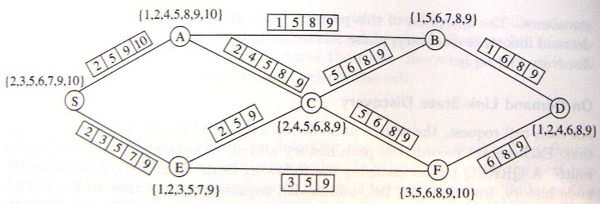
Network layer solutions
On-demand Link-State Multipath QoS Routing protocol(2)
On-demand Link-state Discovery
    A QRREQ packet contains the following fields
      Source ID, Destination ID, node history, free time-slot list, bandwidth requirements, TTL
    When receiving QRREQ,
      1. Node N checks its address in route list. If it is in the list, the packet is discarded
      2. else,
      -1) TTL = TTL -1; if TTL == 0, the packet is discarded
      -2) add its add in node history field, and re-broadcasts the packet
  Build a partial view of network

Slide 23
Network layer solutions
On-demand Link-State Multipath QoS Routing protocol(3)
Unipath discovery
  Build 2 trees: T and TLCF
    Given a path S→A→B … → K →D, and a = BW(S,A), b= BW(A,B) …
    Build T:
      1.) Root is represented as abcd…xy
      2.) ab means time slot is reserved
      3.) build child abcd…, abcd…, abcd…, … ,abc…xy. Recusively
      4.) the reserved time slots are calculated in every link
    Build TLCF:
      Sort the reserved time slots in the same level in ascending order from left to right

Slide 24
Network layer solutions
On-demand Link-State Multipath QoS Routing protocol(4)
Unipath discovery, an example
S
A
B
D
a
2,5,9,10
b
1,5,8,9
c
1,6,8,9
Build tree T:
Build tree TLCF:
abc
abc
abc
abc
2
abc
abc
3
2
3
1
c
a
3
a
c
3
1

Slide 25
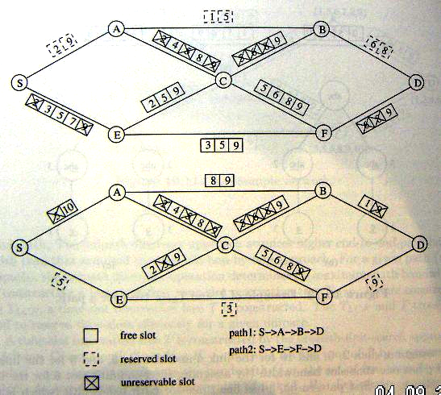
Network layer solutions
On-demand Link-State Multipath QoS Routing protocol(5)
2 unipaths are found
  S,A,B,D
  2 time-slots path bandwidth
  S,E,F,D
  1 time-slot path bandwidth

Slide 26
Network layer solutions
On-demand Link-State Multipath QoS Routing protocol(6)
Multipath discovery and reply
  The destination initiates the multipath discovery operation by using unipath operation
    The sum of path bandwidths fulfills the original bandwidth request
    Determines the max achievable path bandwidth of each path
  The destination sends a reply packet back to source along the path, and all nodes on the path reserves the resources
Advantage
  Better average call acceptance rate
Disadvantage
  High control overhead to maintain and repair paths

Slide 27
Network layer solutions asynchronous slot allocation strategies(1)
AQR
  Uses RTMAC (real time MAC), and is an extension of DSR (dynamic source routing)
  3 phases
    Bandwidth feasibility test phase
    Bandwidth allocation phase
    Bandwidth reservation phase

Slide 28
Network layer solutions asynchronous slot allocation strategies(2)
Bandwidth feasibility test phase
  RouteRequest packet
    If enough bandwidth is available, the packet is forwarded
    The routing loop is avoided by identifying <seq. num. , source ADD. ,and traversed path informations.
    Offset time field records the sum of processing time in all nodes
      Used to estimate the propagation delay of transmission
      Reduces the synchronization problem
  The destination selects a shortest path with enough bandwidth
    And construct a data structure called QoS frame for every link in the path
      To calculate the free bandwidth slots

Slide 29
Network layer solutions asynchronous slot allocation strategies(3)
Bandwidth allocation phase
  A bandwidth allocation strategy to assign free slots to each intermediate link in the path
    Early fit reservation
    Minimum bandwidth-based reservation
    Position-based hybrid reservation
    K-hopcount hybrid reservation
  The information is included in RouteReply packet through the path to the source

Slide 30
Network layer solutions asynchronous slot allocation strategies(4)
Slot allocation strategies
  Early fit reservation (EFR)
    1. Order the links in the path from source to destination
    2. Allocate the first available free slot for the first link in the path
    3. For each subsequent link, allocate the first immediate free slot after the assigned slot in the previous link
    4. Continue step 3 until the last link is reached
    Attemps to provide the least end-to-end delay
    End-to end delay can be obtained as
    tsf * (n-1) /2
    n : hop count, tsf : the duration of the superframe

Slide 31
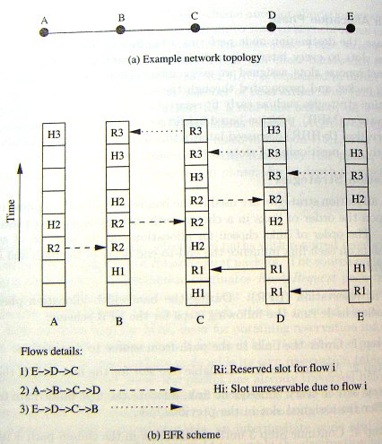
Network layer solutions asynchronous slot allocation strategies(5)

Slide 32
Network layer solutions asynchronous slot allocation strategies(6)
  Minimum bandwidth-based reservation (MBR)
      1. Order the links in the non-decreasing order of free bandwidth
      2. Allocate the first free slot in the link with lowest free bandwidth
      3. Reorder the links, and assign the first free slot on the link with lowest bandwidth
      4. Continue step3 until bandwidth is allocated for all links
    Allocates the badwidth in increasing order of free bandwidth
    The worst case end-to-end delay can be (n-1)* tsf

Slide 33
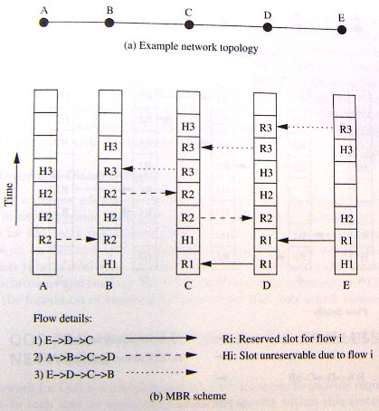
Network layer solutions asynchronous slot allocation strategies(7)

Slide 34
Network layer solutions asynchronous slot allocation strategies(8)
  Position-based hybrid reservation (PHR)
      1. Order the links in the increasing bandwidth
      2. Assign a free slot of the link with least amount of bandwidth, such that the position of assignment of bandwidth is proportional to i/Lpath
        i is the position of the link, and Lpath is the length of the path
      3. Repeat step 2, until bandwidth is allocated for all links
  K-hopcount hybrid routing (k-HHR)
    if (pathlength > k )
    use EFR
    else
    use PHR;

Slide 35
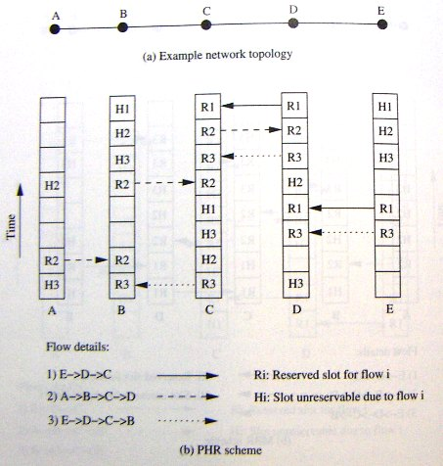
Network layer solutions asynchronous slot allocation strategies(9)

Slide 36
Network layer solutions asynchronous slot allocation strategies(10)
Advantages
  Provide end-to-end bandwidth reservation in asynchronous networks
  The slot allocation strategies can be used to plan for the delay requirements
  Dynamically choose appropriate algorithms
disadvantages
  Setup and reconfigure time can be high
    On-demand routing
  Bandwidth efficiency may not as high as fully synchronized TDMA system
    Formation of bandwidth holes (short free slots can’t be used)

Slide 37
Outline
Introduction
Issues and challenges in providing QoS in Ad hoc wireless networks
Classifications of QoS solutions
MAC layer solutions
Network layer solutions
QoS frameworks for Ad Hoc wireless networks
summary

Slide 38
QoS frameworks for Ad Hoc wireless networks
A framework for QoS is a complete system that attempts to provide required/promised services to each user
The key component is QoS service model
  To serve users on a per session basis or on a per class basis
The other key components
  Routing protocol
  QoS resource reservation signaling
  Admission control
  Packet scheduling

Slide 39
QoS frameworks for Ad Hoc networks
QoS models(1)
In wired network, IntServ and DiffServ have been proposed
  IntServ provides QoS on a per flow basis
    3 types of services
      Guaranteed service
      Controlled load service,
      Best effort service
    RSVP is used
    Not scalable for internet
  DiffServ
    Flows are aggregate into service classes
Both service model cant directly applied to ad hoc wireless networks

Slide 40
QoS frameworks for Ad Hoc networks
QoS models(2)
FQMM
  Flexible QoS model for mobile ad hoc networks
  A hybrid service model
    Per flow granularity of IntServ
    Aggregation of services into classes in DiffServ
  Assumes that the number of flows requiring per flow QoS services is much less than the low-priority flows
  Nodes are classified into 3 different categories
    Ingress node (source)
      Responsible for traffic shaping
    Interior node (intermediate relay node)
    Egress node (destination)
  High priority flows are provided with per flow QoS services
  Lower priority flows are classified into service classes

Slide 41
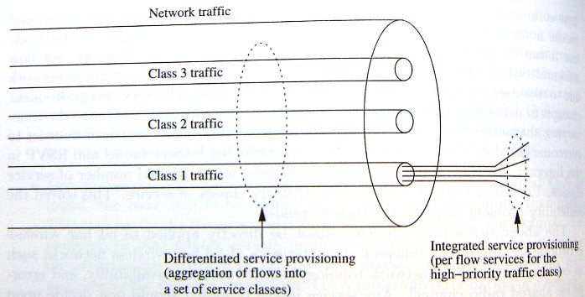
QoS frameworks for Ad Hoc networks
QoS models(3)

Slide 42
QoS frameworks for Ad Hoc networks
QoS models(4)
Advantages
  Provides the ideal per flow QoS services
  Overcomes the scalability problem
Disadvantages
  Several issues remain un-solved
    Decision upon traffic classification
    Allotment of per flow or aggregated service for the given flow
    Amount of traffic belonging per flow service
    The mechanisms used by the intermediate nodes to get information regarding the flow
    Scheduling or forwarding of the traffic by the intermediate nodes

Slide 43
QoS frameworks for Ad Hoc networks
QoS resource reservation signaling(1)
The QoS resource reservation signaling scheme is responsible for
  reserving the required reources
  Informing the applications to initiate transmission
Signaling protocol consists of 3 phases
  Connection establishment
  Connection maintenance
  Connection termination

Slide 44
QoS frameworks for Ad Hoc networks
QoS resource reservation signaling(2)
MRSVP
  A resource reservation protocol for cellular networks
  Assumes that a mobile host predicts precisely the location that the host is going to visit
    Reservation is made before the host uses the path
  2 types of reservation
    Active
      Data packets currently flow along that path
      Made by local proxy agent
    Passive
      Resources are reserved to be used in future
      Made by remote proxy agent

Slide 45
QoS frameworks for Ad Hoc networks
QoS resource reservation signaling(3)
Limitations of adapting MRSVP in Ad hoc network
  Random and unpredictable movement of intermediate nodes
    Extremely to obtain the future locations of the host in advance
      Passive reservations could fail
    Even the future location are known
      Finding a path and reserving the resources on that path may not be a efficient solution

Slide 46
QoS frameworks for Ad Hoc networks
INSIGNIA(1)
Developed to provide adaptive services in ad hoc wireless networks
2 service levels:
  Base QoS: Minimum QoS requirements
  extended QoS: when sufficient resources are available
User sessions adopt to available service level without explicit signaling between source- destination pairs
2 design issues
  How fast can the application switch between base QoS and extended QoS?
  How and when is ti possible to operate on the base QoS or extended QoS for an adaptive application

Slide 47
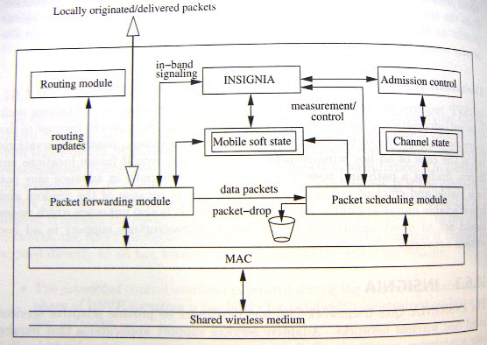
QoS frameworks for Ad Hoc networks
INSIGNIA(2)
Key components of INSIGNIA

Slide 48
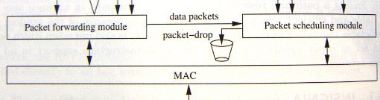
QoS frameworks for Ad Hoc networks
INSIGNIA(3)
Medium Access Control (MAC)
  Provide access to wireless medium
  INSIGNIA is transparent to underlying MAC protocol
Packet Forwarding Module
  Classifies the incoming packets, and delivers them
    If the packet has INSIGNIA option
      Deliver it to INSIGNIA signaling module
    If the node is the destination of the packet
      Deliver it to application
    If the node is not the destination of the packet
      Relay it with the help of scheduling module
Packet Scheduling Module
  The packets to be sent are scheduled based on the forwarding policy
  Uses a weighted RR service discipline

Slide 49
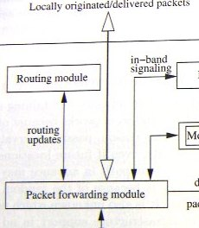
QoS frameworks for Ad Hoc networks
INSIGNIA(3)
Routing module
  Independent from other modules
    Any routing protocol can be used
In-band signaling
  Used to establish, adapt, restore, and tear down adaptive services between source-destination pairs
  Independent from MAC protocol
  Control information is carried along with data packets
    No explicit control channel
    Each data packet has an optional QoS field to carry control information
  Can operate at speeds close to packet transmissions
    Better suited for highly dynamic mobile network

Slide 50
QoS frameworks for Ad Hoc networks
INSIGNIA(4)
Admission control
  Allocates bandwidth to flows based on max/min bandwidth requirements
  Soft state
  When a intermediate node receives a packet with RES flag on,
    If no reservation is made so far, the module allocates the resources
    If other reservation is made, the module re-checks the availble resources
  If no data are received for a period of time, the reservation times out and get released in a distributed manner
    The value of timeout should be set carefully to avoid false restoration
      Time interval is smaller than the inter-arrival time of packets

Slide 51
QoS frameworks for Ad Hoc networks
INSIGNIA(5)
The service level can be upgraded or degraded in a distributed manner
The INSIGNIA option field contains the following field
  Service mode
    Best-effort (BE) or requiring reservation (RES)
  payload type
    Base-QoS, enhanced QoS
  bandwidth indicator
    Has Min/Max value to reflect the status of the flow
  bandwidth request

Slide 52
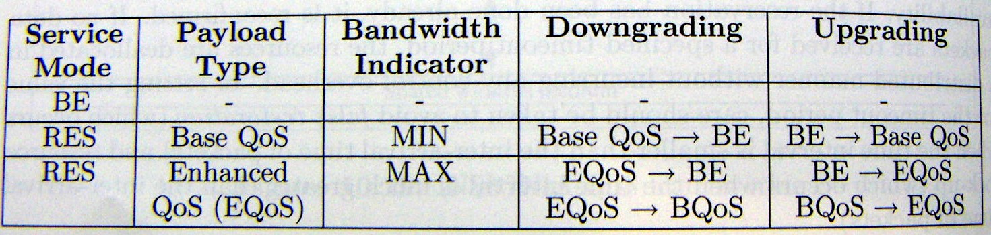
QoS frameworks for Ad Hoc networks
INSIGNIA(6)
For base-Qos application, bandwidth indicator is set to min
For exhanced-Qos application, bandwidth indicator is set to max
  Can be degraded at intermediate nodes if no enough resources are available
    Bandwidth indicator set to min
    Service mode set to BE
    Can be restored when resources are available

Slide 53
QoS frameworks for Ad Hoc networks
INSIGNIA(7)
Releasing Resources
  The destination monitors the delivered flow, and measures the QoS, and sends a reports back to source
  when source sends an enhanced QoS packet with MAX requirements
    At non-bottleneck nodes, the resources are reserved as requested
    At bottleneck nodes, the bandwidth indicator flag are set to MIN
    So resources are over-allocated at non-bottleneck nodes
  When nodes receiving the report from destination
    they release the extra allocated resources

Slide 54
QoS frameworks for Ad Hoc networks
INSIGNIA(8)
Route Maintenance
  Supports 3 types of flow restoration
    Immediate restoration
      Occurs when a rerouted flow immediately recovers to its original reservation
    Degraded restoration
      Occurs when a rerouted flow is degraded for a period bfore it recovers to its original reservation
    Permanent restoration
      Occurs when the rerouted flow never recovers to its original reservation

Slide 55
QoS frameworks for Ad Hoc networks
INSIGNIA(9)
Advantages
  An integrated approach provisioning QoS
Disadvantages
  Supports only adaptive applications
    Multimedia applications
  Transparent to MAC protocol
    fairness and reservation scheme have a significant influence in provisioning QoS guarantees
  Assumes that routing protocol provides new routes when topology changes
    The route maintenance mechanism significantly affects the real time traffic
    The QoS can be downgraded
    No suitable for realtime application

Slide 56
QoS frameworks for Ad Hoc networks
INORA
Coarse feed back scheme
    When a node fails to provide QoS, it sends an admission control failure (ACF) msg. to its upstream node
    The upstream reroutes the flow through other nodes
    If no neighbor can provide the requested QoS, it sends an ACF to upstream node
  When this happens, the packets are sent as best-effort packets from source to destination
123

Slide 57
QoS frameworks for Ad Hoc networks
INORA(1)
USE
  INSIGNIA in-band signaling mechanism
  TORA routing protocol
Coarse Feedback Scheme
Class-based Fine Feedback Scheme

Slide 58
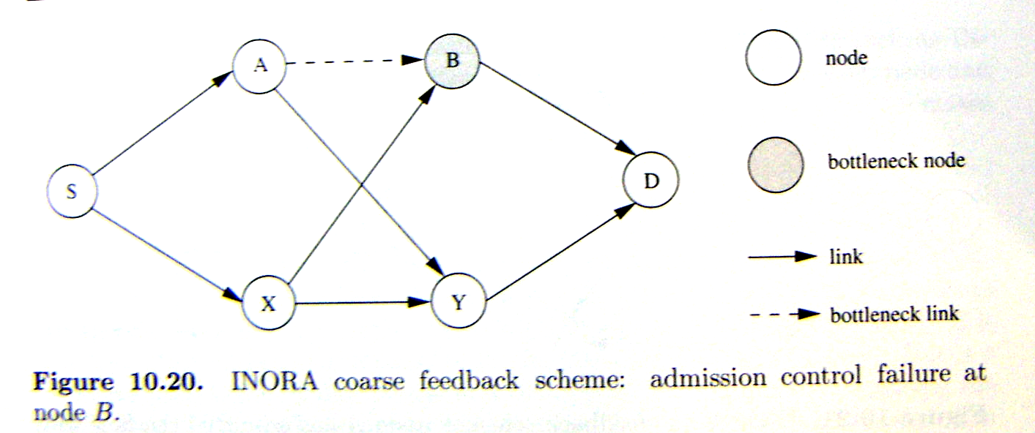
QoS frameworks for Ad Hoc networks
INORA(2)

Slide 59
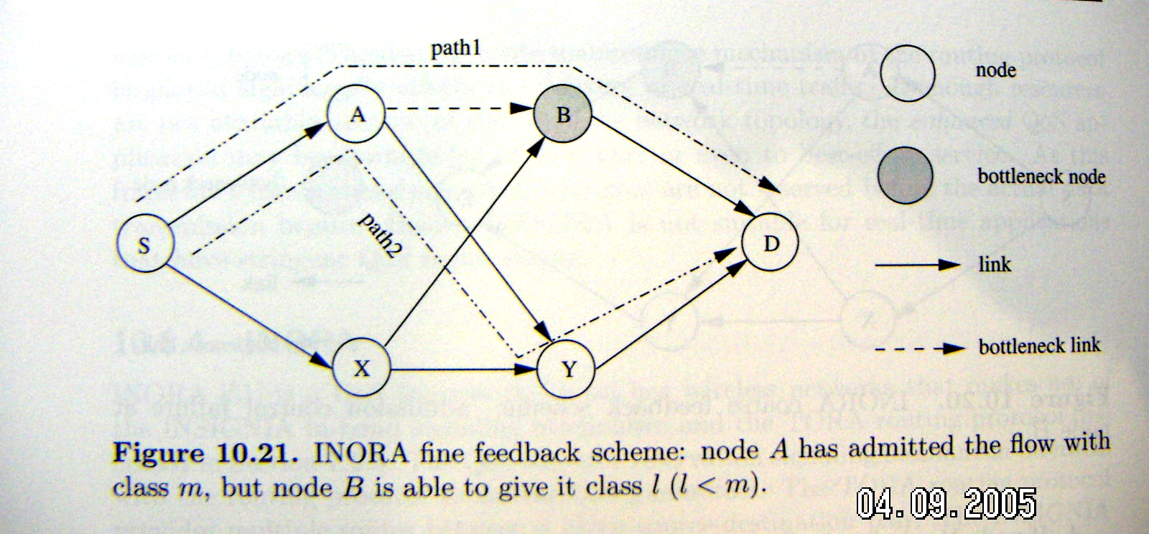
QoS frameworks for Ad Hoc networks
INORA(3)

Slide 60
QoS frameworks for Ad Hoc networks
INORA(4)
Advantages
  Search multiple paths with lesser QoS guarantees (Compare with INSIGNIA)
  Use the INSIGNIA in-band signaling mechanism
Disadvantages
  May not be suitable for applications that require hard service guarantees
    Because of the failure flow may only service as BE

Slide 61
QoS frameworks for Ad Hoc networks
SWAN(1)
Stateless wireless ad hoc network
  Assimes a best-effort MAC protocol
  Uses feedback-based control mechanisms to support real-time services and service differentiation
  Uses local rate control, a source-based admission control, an explicit congestion notification (ECN)
  Unlike INSIGNIA and INORA, intermediate nodes don’t have to maitaining the per-flow state information

Slide 62
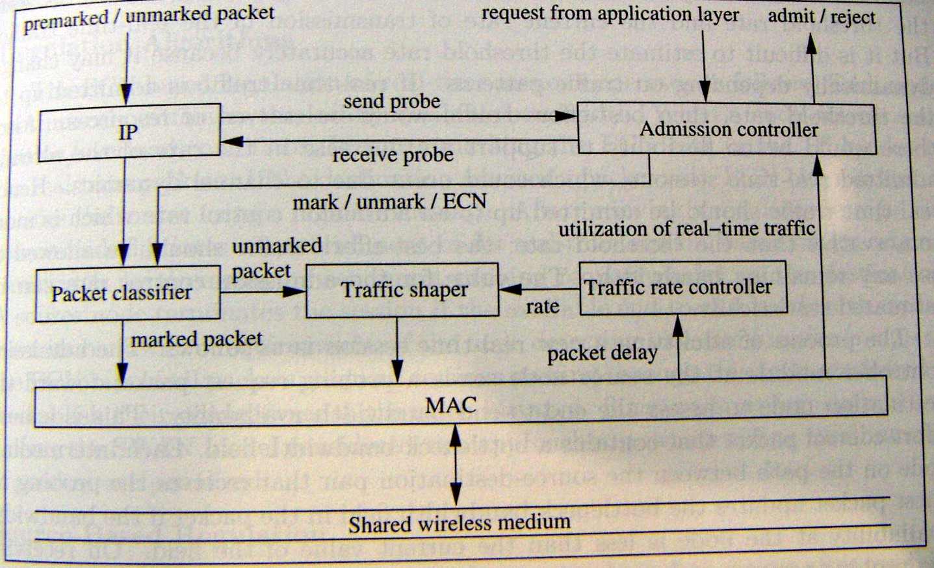
QoS frameworks for Ad Hoc networks
SWAN(2)

Slide 63
QoS frameworks for Ad Hoc networks
SWAN(3)
Local rate control of BE traffic
  Assumes most traffic are BE
  Uses the bandwidth left out by real time traffic
  Traffic rate controller determines the departure rate of the traffic using AIMD (additive increase multiplicative decrease) algorithm
    Every T secs, tx rate = tx rate + c (Kbps)
    If rx rate exceeds the threshold
    tx rate = tx rate * r percent
    If shaping rate is greater than g percent of the actual rate
      shaping rate is adjusts to be g percent above the actual rate

Slide 64
QoS frameworks for Ad Hoc networks
SWAN(4)
Source-Based admission control of real-time traffic
  The real time traffic should be admitted up to an admission control rate; the best effort traffic should be allowed to use any remaining bandwidth
  Process of admitting a new real time session
    The source sends a probe packet to estimate the end-to-end bandwidth
      Each intermediate nodes update the bottleneck bandwidth field
    Admits the real time sessions only if sufficent bandwidth is available
  No bandwidth request is in probe packet, and no resource allocation or reservation is done during the lifetime of an admitted session

Slide 65
QoS frameworks for Ad Hoc networks
SWAN(4)
Routing algorithms
  1. Each node continuously estimates the locally available bandwidth
  2. When a node detects congestion conditions, it starts marking the ECN bits in real time packets
  3. When destination receives these packets, it sends a regulate msg. back to source
  4. The source re-establish the session based on the original bandwidth requirements by sending a probe packet to destination
The above approach is not efficient, the SWAN model consider 2 approaches
  Source-based regulation
  Network-based regulation

Slide 66
QoS frameworks for Ad Hoc networks
SWAN(5)
  Source-based regulation
    The source waits for a random amount of time after receiving a regulate msg. , then initiates the re-establishment process
    Avoid flash-crowd conditions
  Network-based regulation
    The congested nodes randomly select a congestion set of rt-sessions, and mark only packets in this set

Slide 67
QoS frameworks for Ad Hoc networks
SWAN(6)
Advantages
  scalable
disadvantages
  Can’t provide Hard QoS
  In worst case, the admitted rt-traffic can be dropped of live in BE mode
  Don’t perform well when most traffic is real time

Slide 68
QoS frameworks for Ad Hoc networks Proactive RTMAC(1)
PRTMAC is a cross layer framework
  On-demand QoS extension of DSR routing protocol at layer 3
  RTMAC at layer 2
    Provides bandwidth availability estimation
Uses an out-of-band signaling channel to gather additional information about the on-going real-time calls
  A narrow band control channel that operates over a transmission range with twice that of the data transmission, is used as the out-of-band signaling channel
  A greater transmission range than data channel
Mobility affects the real-time traffic in 2 ways
  Breakaways
  Reservation clashs

Slide 69
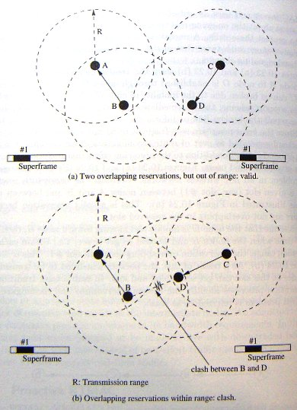
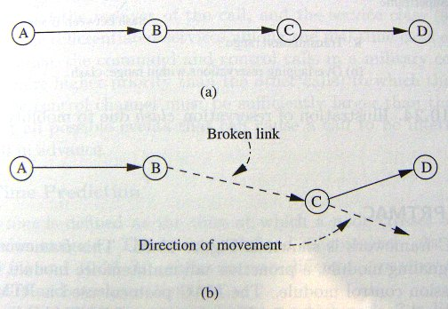
QoS frameworks for Ad Hoc networks Proactive RTMAC(2)
Breakway
clash

Slide 70
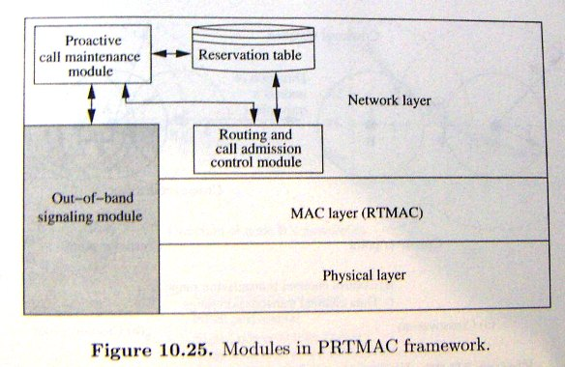
QoS frameworks for Ad Hoc networks Proactive RTMAC(3)
Operation of PRTMAC
  Every node sends out control beacons at regular intervals over control channel
    The calls the source node is carrying
    Start- and end- time of the real time call
    The slot reservation status
  Signal strength is used to estimate the relative distance between 2 nodes

Slide 71
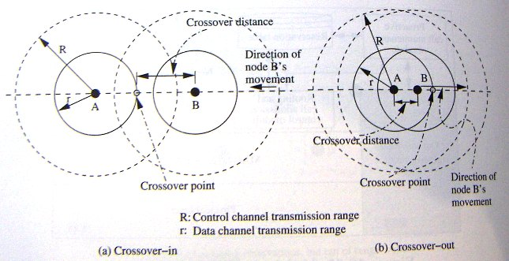
QoS frameworks for Ad Hoc networks Proactive RTMAC(4)
Crossover-time prediction
  The time when a node crosses another node’s data transmission range
  A node stores number of <time, signal strength> tuples received from other nodes

Slide 72
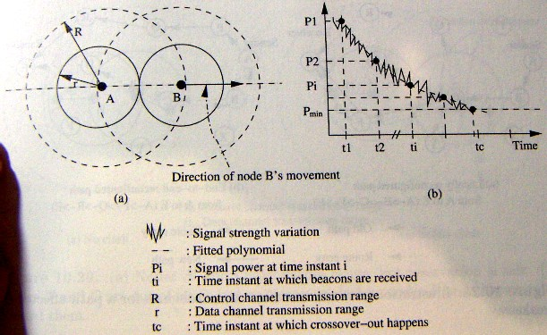
QoS frameworks for Ad Hoc networks Proactive RTMAC(5)

Slide 73
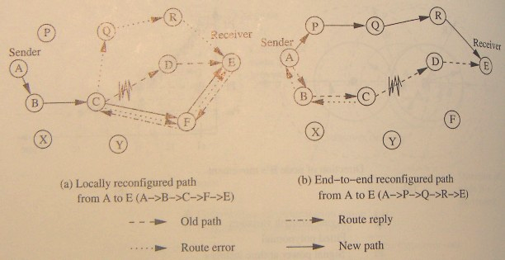
QoS frameworks for Ad Hoc networks Proactive RTMAC(6)
Handling Breakaways
    Local reconfiguration
      When a node’s downstream node is down, the node tries the local reconfiguration
    End-to-end reconfiguration
      Sends a RouteError packet back to source
  Combines these two
    Node C checks if there is a path to F in its routing table
    If there is one, C makes the reservation.
    When a call is interrupted, and local reconfiguration is tried for a number of times, the end-to-end reconfiguration is attempted

Slide 74
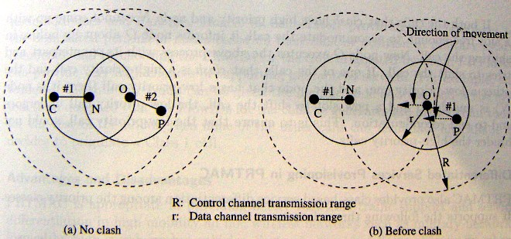
QoS frameworks for Ad Hoc networks Proactive RTMAC(7)
Handling Clashs
  When clashs happens, the PRTMAC shifts one of the calls to a new slot

Slide 75
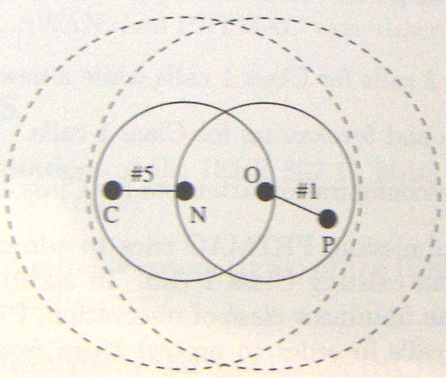
QoS frameworks for Ad Hoc networks Proactive RTMAC(8)
when clash happens,
  suppose that N is responsible for reconfig calls
N tries to find a free slot in N and C
  By going through its reservation table and its neighbor’s table corresponding to C
If success →
  Shifts the call
If failed →
  Low priority gets dropped, and undergoes an end-to-end reconfiguration

Slide 76
QoS frameworks for Ad Hoc networks Proactive RTMAC(9)
Diffserv provisioning in PRTMAC
  Class 1
    Real-time calls
    Preempt the law priority calls
  Class 2
    End-to-end bandwidth reservation
  Best-effort

Slide 77
QoS frameworks for Ad Hoc networks Proactive RTMAC(10)
Advantage
  Provides better rt-traffic support and service differentiation in high mobility ad hoc wireless networks
disadvantage
  Having another control channel may be a problem in low-power and resource-constrained environments

Slide 78
Outline
Introduction
Issues and challenges in providing QoS in Ad hoc wireless networks
Classifications of QoS solutions
MAC layer solutions
Network layer solutions
QoS frameworks for Ad Hoc wireless networks
summary

Slide 79
Summary
The issues and challenges in providing QoS
Classfication of QoS
MAC/ network layer solution
frameworks

